Slide 1
5 Million Thoughts about the Past and Future Reveal Shared Reliance on Schemas
Robert Thorstad

Slide 2

Common Mental Processes?
Notes:
How do people think about the future?
One possibility: using the same mental processes used to think about the past. In particular simulation processes involving generation of episodic detail.

Slide 3
Evidence for
Common Processes
Notes:
This is a recent proposal, and there’s a few types of evidence for it:

Slide 4
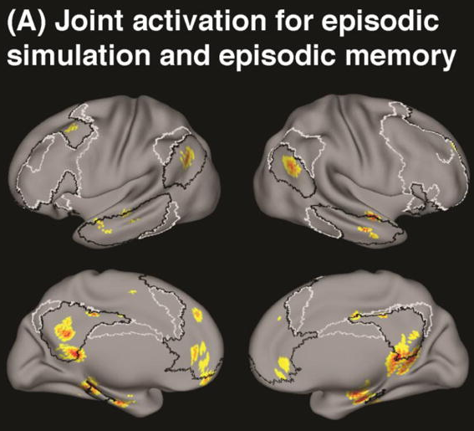
Benoit & Schacter, 2015;
Spreng, Mar, & Kim, 2009
Notes:
Perhaps the strongest evidence comes from cognitive neuroscience. When people are in an FMRI scanner while they remember the past or imagine the future, common neural areas are activated. Specifically in the default network. This is very robust across individual studies and across meta-analyses.

Slide 5
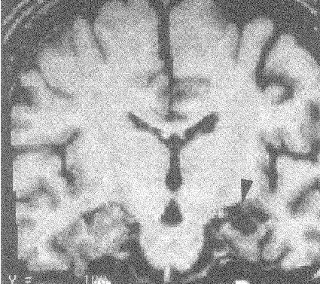
Episodic Memory Deficits
Klein et al, 2002;
Race, Keane, & Verfaellie, 2013
Notes:
There was suggestive evidence from patients with episodic memory deficits. The idea was that these patients had deficits to the LIVED past (what did you do yesterday?) and LIVED future (what will you do tomorrow?) but preserved KNOWN future (what will be an important world issue in 10 years)? This suggested (1) common processing and that (2) episodic memory was the cognitive process.

Slide 6
Existing Proposals:
1. Past and future thinking rely on shared processes
2. The shared process is episodic processing
Notes:
This is a recent proposal, and there’s a few types of evidence for it:

Slide 7
Evidence Against
Common Processes

Slide 8
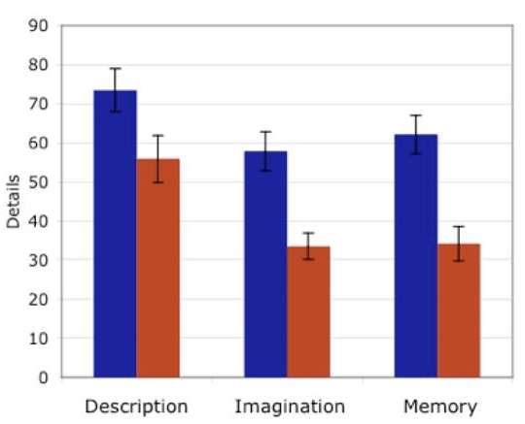
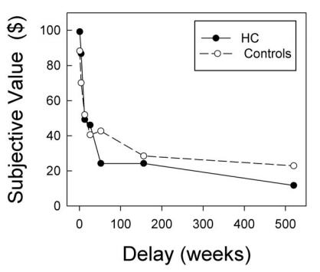
Patients:
Uniqueness?
Sacchetti et al, 2011;
Hassabis et al, 2007a; 200b
Kwan et al, 2012; 2013; 2014
Notes:
While there is evidence for common processes for past and future thinking, there are a few issues.
The main issue is a failure to establish uniqueness to past and future thinking, which is a logical necessity. When a few studies have tried to establish this uniqueness, it’s not clear they have been successful; here, with respect to internal details (e.g. episodic processing) for past and future compared to simply describing a picture.
The other issue is that a lot of episodic patients with memory deficits actually can thinking about the future; here I’m showing normal future decision-making in a patient, and there is also a patient who scores as future-oriented on a time perspective survey. Again this suggests at least that episodic processing may not be the common process.

Slide 9
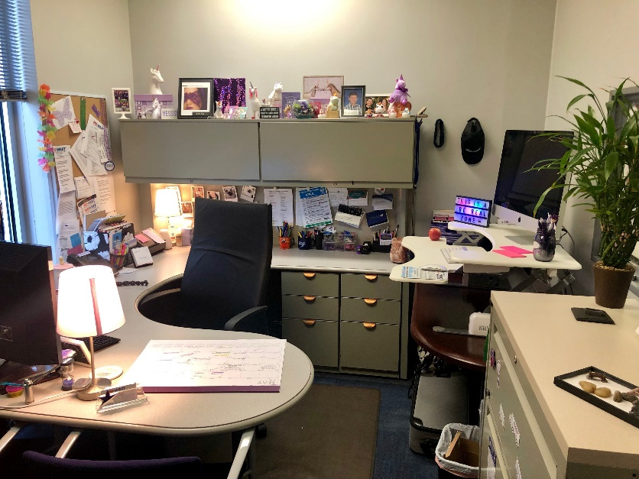

Hypothesis
Past and future thinking rely on common processes, but common process is use of schemas.
Future Thinking
Memory
Brewer & Treyens, 1981;
Bauer, 1993; Fivush, 2002
Notes:
In this dissertation I offer a new proposal: that past and future thinking may involve shared processes, but NOT the use of EFT. Rather the use of schemas. Schemas are known to be important for PT and intuitively (but little empirical data) should be important for FT.

Slide 10
Approach
1
Study natural, unprompted temporal thoughts
2
Test for uniqueness to mental time travel
Present = Time Travel – Travel
Notes:
. I’ll test this proposal by:
Test for uniqueness to mental time travel (P, F) compared to probably the strongest possible control: talk about the present.
Study natural, unprompted talk about time. Why umprompted? Well it’s possible the prompts can induce the very similarities we’re trying to study; certainly the strongest evidence for similarity would come if it’s unprompted. I develop NLP and ML techniques to extract >5 million natural thoughts about time.

Slide 11

Study 1
Episodic Future Thinking
Notes:
Motivation. Most of the proposals for common processing assume that the shared process is episodic future thinking – think in part of the patient data, and, the fact that MTL regions like hippocampus come up in the neuroimaging. EFT is defined by analogy to the episodic memory system, thought to involve pre-experiencing or simulation of future events. E.g., mentally simulate playing tennis.

Slide 12
Question
Is mental time travel uniquely associated with episodic processing?
Notes:
Question: Is Episodic processing uniquely associated with mental time travel?

Slide 13
Approach
Natural Temporal References
Linguistic Markers
of episodic processing
Compare
Past
Present
Future
Notes:
Approach: Compare episodic processing in past and future to present (to establish uniqueness). Do this by automatically identifying >5 million temporal thoughts, and, extracting linguistic markers of episodic processing.

Slide 14

Natural Temporal Thoughts
Blog Authorship Corpus
145 M words
19,350 unique authors
Koppel et al, 2006
Notes:
Methods: Some of the methods are novel (and repeated across studies) so let’s spend some time on them.
Source for temporal thoughts: blog corpus. A good source should be unprompted, involve a large number, reasonably balanced demographically. So we chose a web blog corpus: the blog authorship corpus.

Slide 15
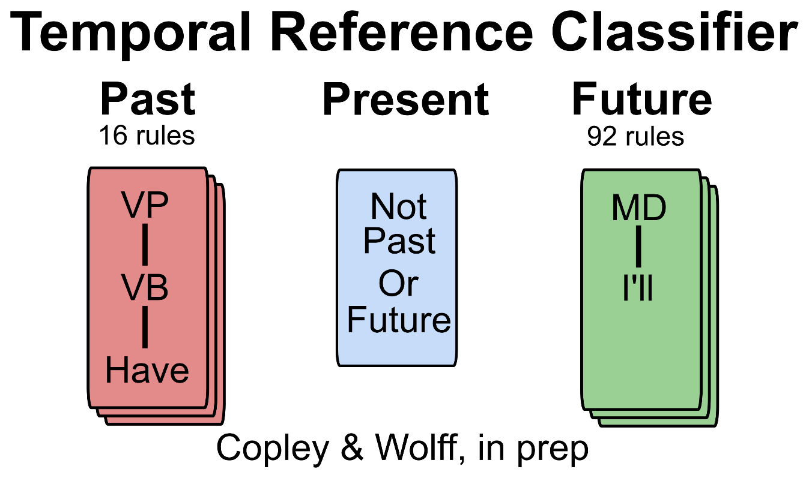
Identifying Temporal Thoughts
Compare To:
LIWC
(keywords only)
SUTime
(rules only)
Schwartz et al (ML)
Humans
Pennebaker et al, 2015; Schwartz et al, 2013; Chang & Manning, 2012
Notes:
Method for extracting temporal thoughts: Temporal thoughts are hard to extract in English because there’s no dedicated future tense morphology (example). There are a few automated approaches but no common evaluation, so, we evaluate them all against each other, and we get a comparison to humans to see how good in general it is.

Slide 16
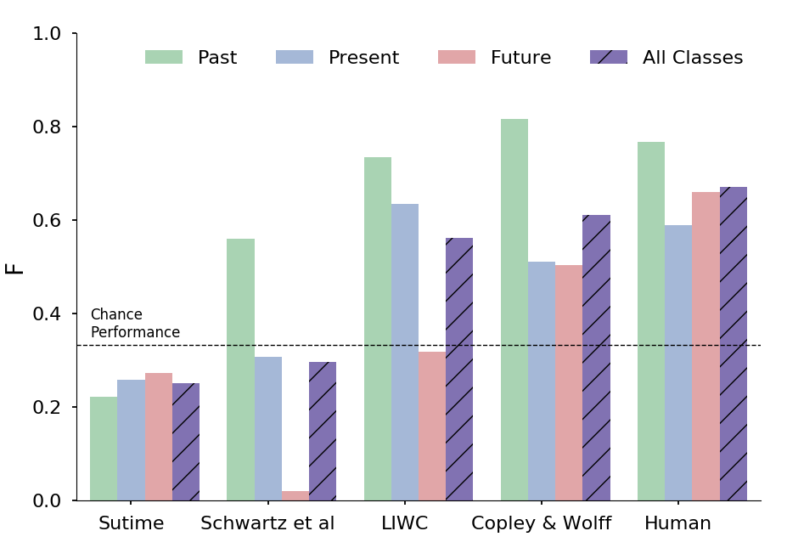
Notes:
Evaluation of temporal reference classifier. First, we checked that automatically identifying temporal thoughts is reasonable. You can see that a few automated approaches do pretty well, almost as well as humans, the Copley & Wolff model being the best.
Examples of temporal references extracted (and descriptive statistics). You can see we were able to extract millions of temporal references. Interestingly future was almost as common as past (confirming existing literature: we think about the future a lot).

Slide 17
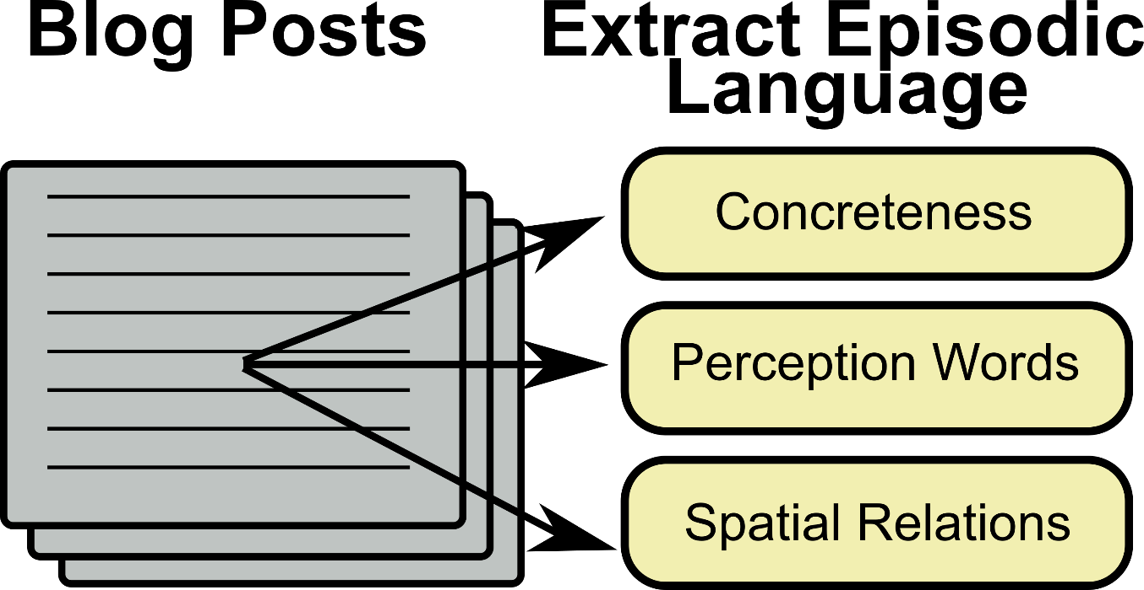
Pennebaker et al, 2015; Brysbaert et al, 2014
Notes:
Measure episodic language using language. This is what we typically do – e.g. the autobiographical memory interview then code it. But you can’t give people a survey: you only have the resulting thoughts. So you need to go backwards to extract markers from language. Three reasonable markers are space, perceptual, concreteness.

Slide 18
Prediction
If mental time travel is uniquely associated with episodic processing:
Episodic Language
Notes:
Predictions: If EFT uniquely associated with P, F, then: [bar graph with P, F high and PR lower].

Slide 19
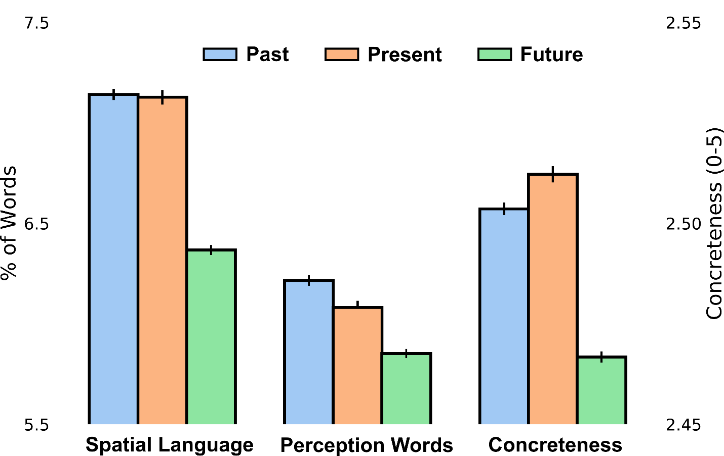
Notes:
Results: We did NOT confirm this prediction.
EFT results. We found instead that EFT was very similar in past and present thoughts, and lower in the future. This is not consistent with EFT being uniquely associated with mental time travel, or, the key shared process

Slide 20


Discussion
Mental time travel not uniquely associated with episodic processing
What about schemas?
Notes:
The main result is that EFT is not the key shared process – and if you think about it, while this is commonly posited as a shared process, it’s consistent with the patient literature showing you can lose EFT and still think about the future.
But. ,the hypothesis of shared processing is broader than that: it’s possible the key shared process is something other than EFT. Schemas are a good candidate: so we test these next.

Slide 21
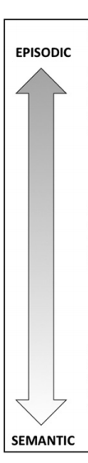
Study 2: Semantic Future Thinking
Szpunar et al, 2014; Irish et al, 2012
Notes:
Motivation: [Fig. of EFT vs. SFT definition] We found that episodic processing is not uniquely associated with mental time travel. But, the hypothesis that past and future thinking are associated with shared processes is not limited to episodic processing (despite a historical focus on episodic processing). Semantic future thinking is thought to encompass thoughts about the future that draw on high-level, factual knowledge without a high level of re-experiencing: knowing that a tennis racket should be packed to the match tomorrow night.

Slide 22


Evidence for Schema Use
Future Thinking
Memory
Semantic dementia
Brewer & Treyens, 1981;
Bauer, 1993; Fivush, 2002
Irish et al, 2012; 2013; 2014
Notes:
Evidence for schema usage: There is a long tradition of evidence that people use conceptual knowledge – in the form of schemas or scripts – to remember the past. There is also some suggestive evidence that schemas may be important to future thinking, primarily from patients with semantic dementia who are impaired in both past and future thinking. Together this suggests that schemas could be associated with past and future mental time travel – although certainly no one has established a unique association.

Slide 23
Question
Is mental time travel
uniquely associated
with semantic processing?
Notes:
Question: Is semantic future thinking uniquely associated with mental time travel into past and future, compared to thinking about the present?

Slide 24
Approach
Measure schema usage in naturally occurring thoughts about the
past, present, and future
Notes:
Approach: We did this by measuring schema usage in the naturally occurring temporal thoughts.

Slide 25



Measuring Schemas: Corpus
Reddit
All posts in Jan. 2017
307M words
1.9M unique authors
115,000 unique subreddits
Baumgartner, 2019
Notes:
Method for identifying schemas: corpus. [Picture of reddit corpus] What you really want is not to have to specify schemas by hand, but to be able to learn them from data. The key innovation is that the presence of large, diverse social media corpora is making possible something like a large-scale snapshot of people’s everyday cognition. We capitalized on this to take an extremely large database of everyday cognition – 1 month of posts on the social media website Reddit – and learn the most common schemas. Because there are more than 100,000 discourse communities on Reddit, our hope is that a model asked to learn only a few hundred schemas should learn the broadly shared topics that cross communities, not the topics of the communities themselves.

Slide 26
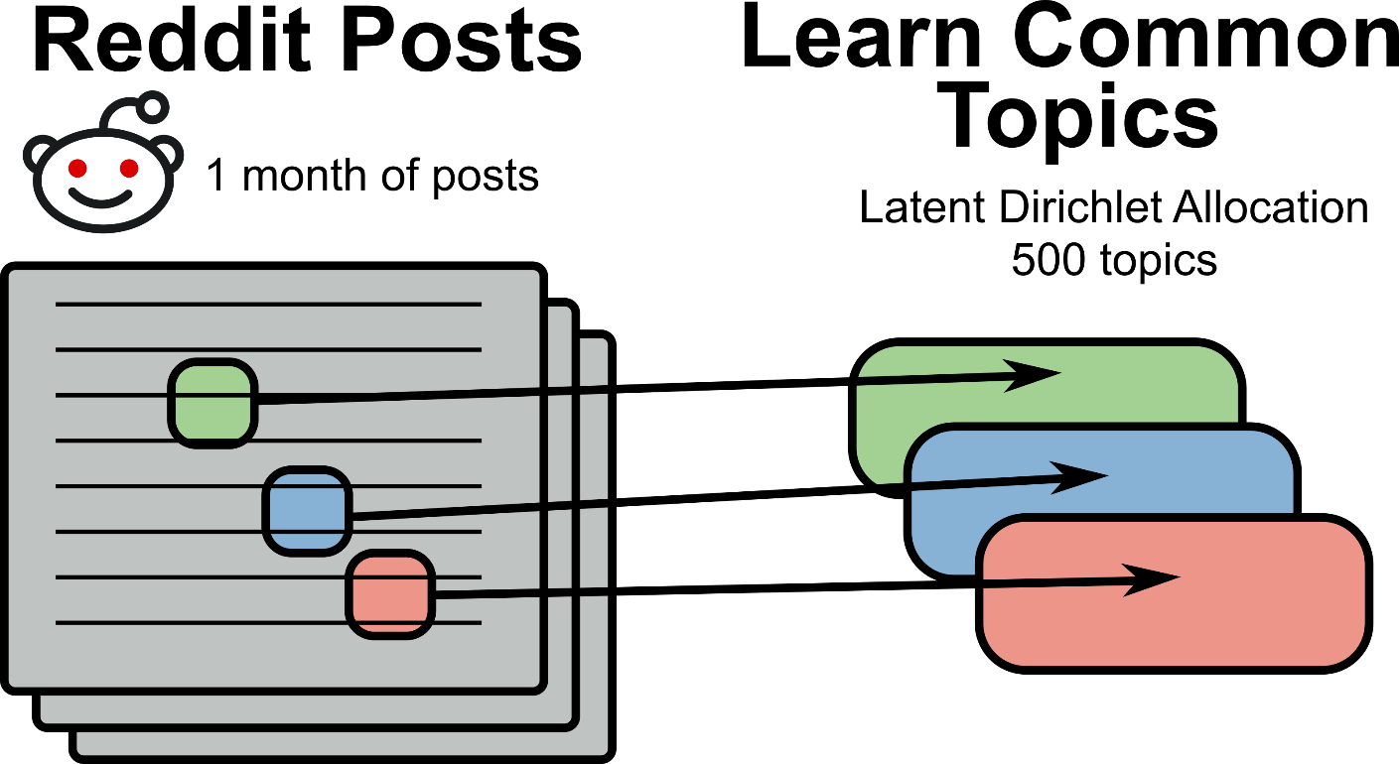
Notes:
Method for identifying schemas: model [Picture of LDA model]. What you really want is to be able to learn common human schemas, rather than specify a few in advance and build up a database that way. This requires a learning model. The model should have a few characteristics. It should learn high-level, semantically coherent packets of information. And these packets should be broadly shared across people and probably consistent over time. The method we used – LDA --- meets these criteria. There are also prior data showing it matches a number of features of humans schemas, what has been missing is letting it loose on a large and general enough corpus to claim you have learned the human schemas.

Slide 27
Topics Learned
Feelings: Feeling | Feels | Felt | Pain | Worse
Reading: Read | Reading | Book | Books | Library
Sounds: Hear | Sound | Sounds | Audio | Hearing | Noise
… N = 500
Notes:
Evaluation of topic model: semantic coherence. The first assumption is that the topic model is learning semantically coherent (and hopefully diverse) packets of information. We can test this assumption in two ways: by looking at the topics (and asking how semantically coherent they are) and by asking people to rate the topics. Here are some fo the topics learned [figure of topics]. And we asked people to rate the semantic coherence of these topics, compared to topics from a semantically ablated model, and the humans rated them as more coherent.

Slide 28
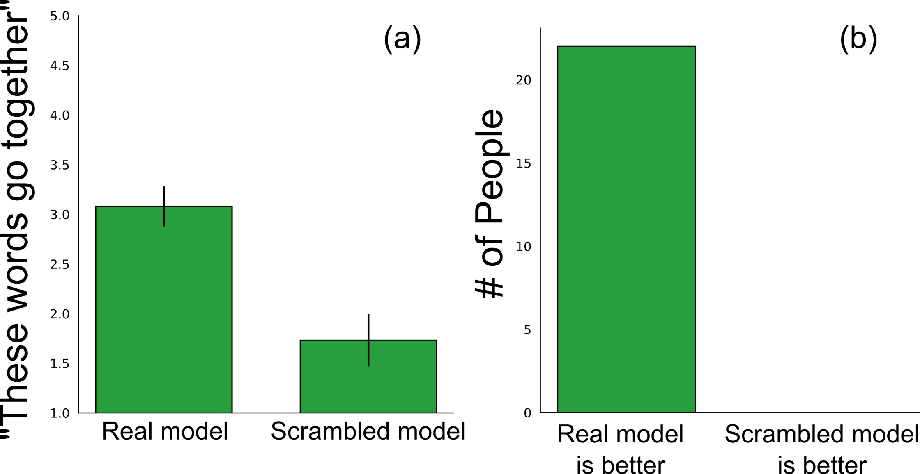
Notes:
Evaluation of topic model: semantic coherence. The first assumption is that the topic model is learning semantically coherent (and hopefully diverse) packets of information. We can test this assumption in two ways: by looking at the topics (and asking how semantically coherent they are) and by asking people to rate the topics. Here are some fo the topics learned [figure of topics]. And we asked people to rate the semantic coherence of these topics, compared to topics from a semantically ablated model, and the humans rated them as more coherent.

Slide 29
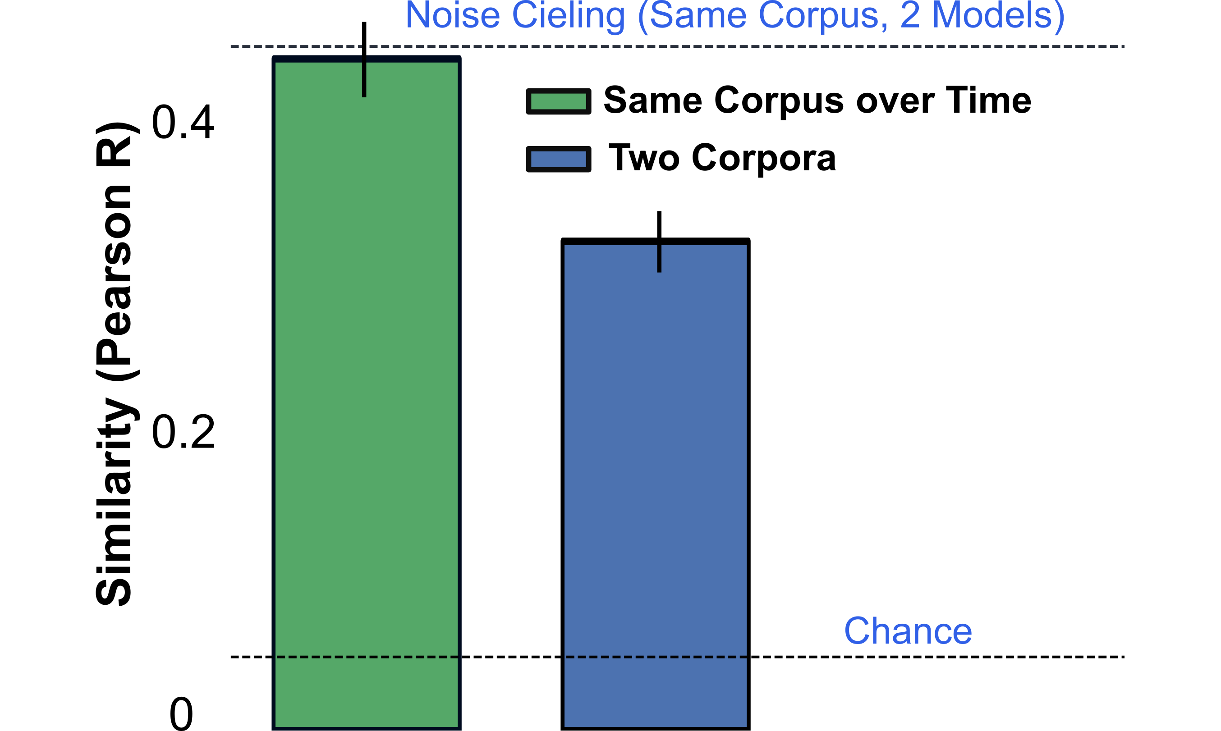

Slide 30
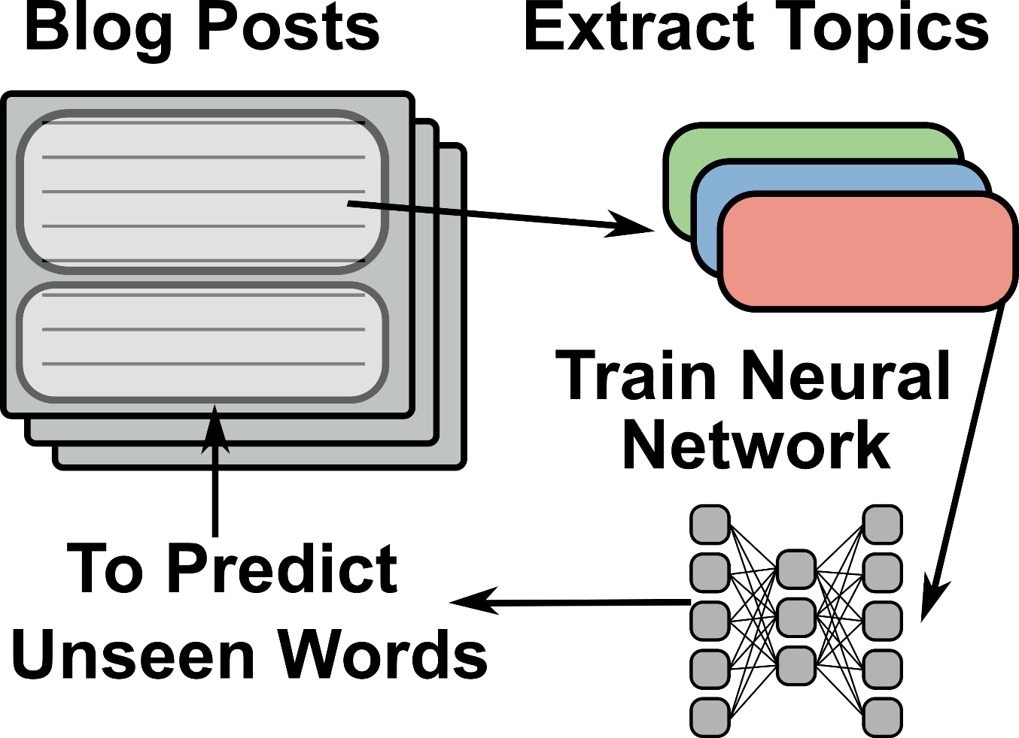
Notes:
Method for identifying schemas: detecting application of schemas [Picture of NN procedure]. Finally, you don’t want to detect that thoughts incidentally conformed to a schema, but rather that the schema was really applied in the situation. The best way to do this is to capitalize on a broadly shared process that schemas are thought to do: to fill in missing information in a situation. We can capitalize on this property in a model by teaching a model to do this, using only the schemas that people have just revealed. It being more successful in predicting the held-out words thus suggests a use of the schemas to fill in missing information. Thus, we can operationalize schema usage as: a NN can use the schemas you just revealed to predict what you are about to write.

Slide 31
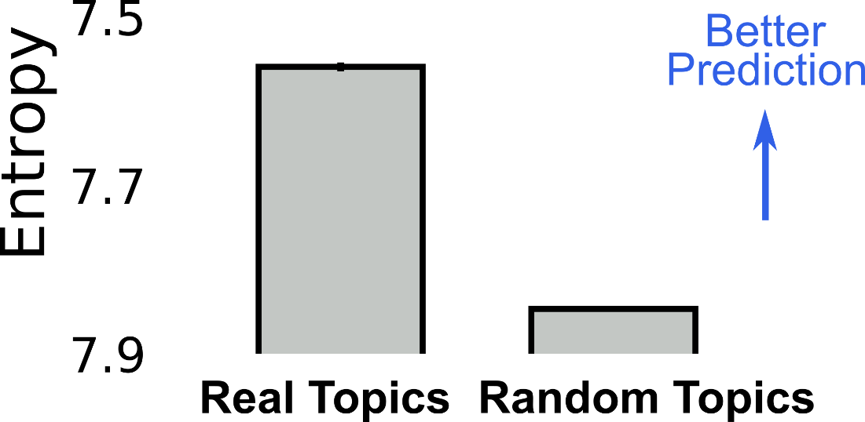
Notes:
Evaluation of topic model: filling-in procedure. We plan to identify schema usage by the ability of a model to use the topics to fill in information, predicting the words that people wrote next. But before we compare this for past, present, future, we have to show that this prediction is possible. We test it by comparing the ability of the topics to predict missing words compared to semantically ablated topics, in which case the model can learn to predict sensible base rates but gets no information from the topics. We found better prediction using the topics.

Slide 32
Prediction
If mental time travel is uniquely associated with semantic processing:
Use of Schemas
Notes:
Schema usage in past, present, and future thoughts. Having established that we can identify schema usage, we can break down the schema usage identified by the model by whether the sentence being predicted refers to the past, present, and future, where again the main prediction is that the model will be better (find more schemas) for sentences involving mental time travel. That’s what we found.

Slide 33
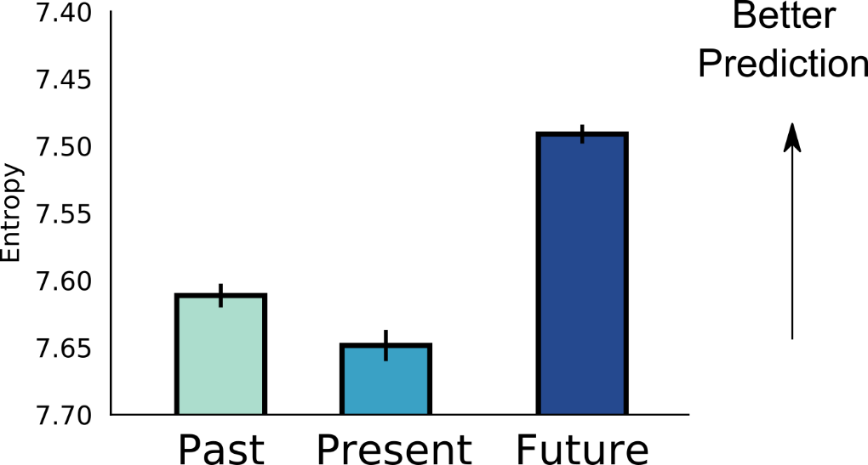
Notes:
Schema usage in past, present, and future thoughts. Having established that we can identify schema usage, we can break down the schema usage identified by the model by whether the sentence being predicted refers to the past, present, and future, where again the main prediction is that the model will be better (find more schemas) for sentences involving mental time travel. That’s what we found.

Slide 34
If uniquely associated with mental time travel:
Mental Process
Past
Present
Future
Episodic Processing
Schemas
Notes:
Schema usage in past, present, and future thoughts. Having established that we can identify schema usage, we can break down the schema usage identified by the model by whether the sentence being predicted refers to the past, present, and future, where again the main prediction is that the model will be better (find more schemas) for sentences involving mental time travel. That’s what we found.

Slide 35

Discussion
Mental time travel is uniquely associated with semantic processing
Only in naturally occurring temporal thoughts?
Notes:
The main finding is that schema usage may be uniquely associated with mental time travel, compared to thoughts about the present. This suggests that past and future thinking may share common cognitive processes but that schema usage, not episodic processing, may be the key shared process.
We also think we’ve made a methodological contribution, in extracting a large-scale model of people’s everyday schemas. There’s been some existing evidence that these models may extract something like a schema, but the innovation was to unleash this model on a large slice of the human conceptual system with the aim of learning about the whole system. We applied this to future thinking, but the application can be as broad as you want (cross-cultural? References that violate/don’t conform to schemas?). Note finally that this model meets a lot of characteristics of schemas, but it does have some limitations, chief among them is that the model is not hierarchical (although it could be extended in this way).
We did find (unexpectedly) that schemas were even more involved in thoughts about the future than the past. And we’re not the only ones to find this. This is in some of Maureen Irish’s patient data, and, there’s data that the hippocampus may be more active for future than past thinking. Any interpretation is utterly speculative, but here’s one possibility: if you break past and future thoughts into construction (access) vs. elaboration, the construction phase may require more schemas for F > P, due to the fact that there’s no memory trace that I can access.

Slide 36
Study 3: Lab-Elicited Temporal Thoughts
Previous studies used naturally occurring temporal thoughts
Results differ using thoughts elicited in the lab?
Notes:
Motivation: All of the previous studies have been based on people’s naturally occurring thoughts about time. We think this has a key advantage: these thoughts are unprompted, thus, similarity can’t be induced by prompting. But, temporal thoughts are typically studied in the lab – and so we can ask (in a limited way) whether we would get similar results using these lab-based methods.

Slide 37
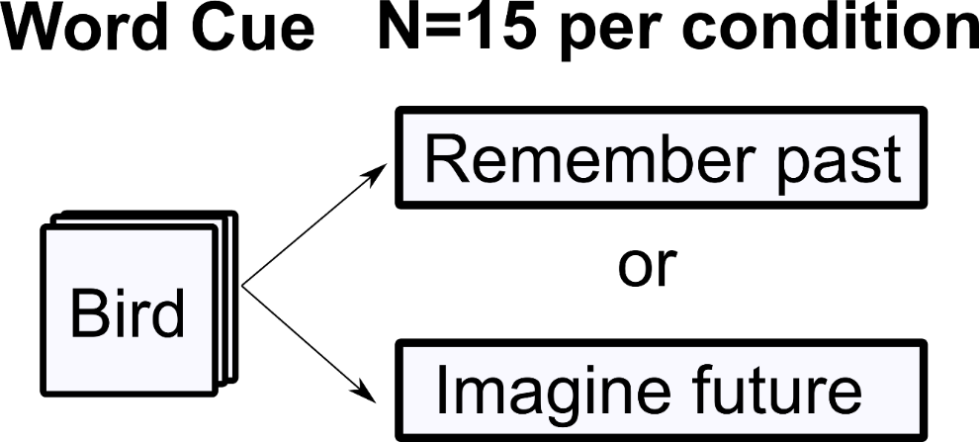
N = 74 Participants
Notes:
Approach: [Figure of crovitz task]. We used a standard task, the Future Crovitz task, to cue people to generate past and future events. We then applied all of the measures I just showed you – chief among them the ability to extract episodic and schematic processes – to measure linguistic indicators of these processes in people’s thoughts. The only note is that the text generated was not very long, so, for the purpose of extracting schemas we used the cue word.

Slide 38
Predictions
Episodic Language
Past Future

Slide 39
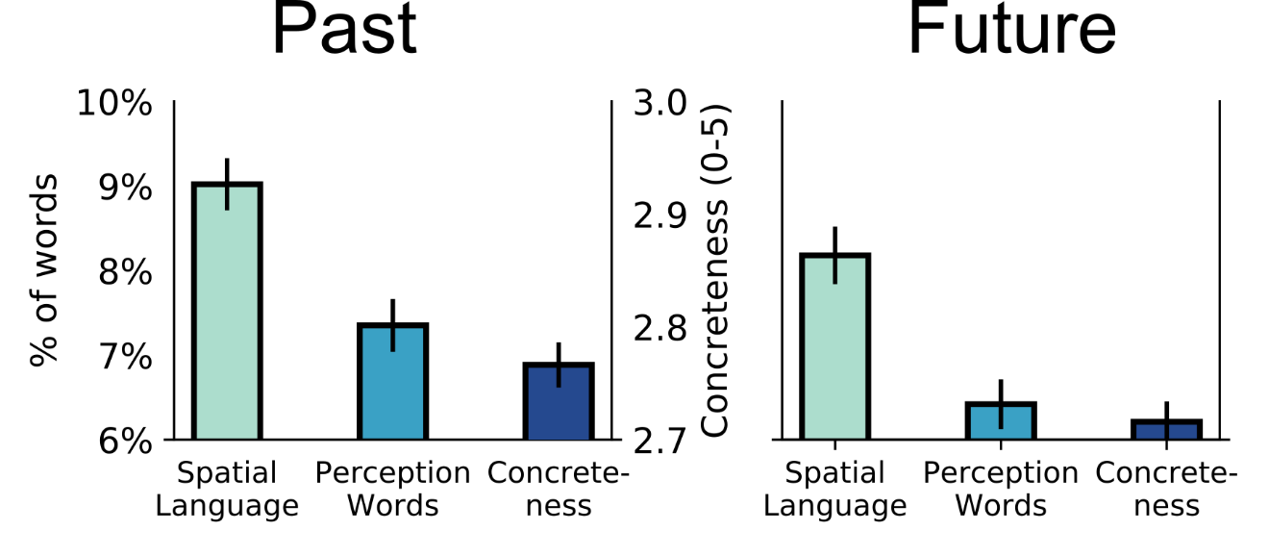
Notes:
Results for episodic language. We found (the same as in the naturally occurring thoughts) that thoughts about the past used more episodic language than thoughts about the future (sig. for 2/3 measures). This suggests, again, the episodic processing is not the shared process.

Slide 40
Predictions
Use of Schemas
Past Future

Slide 41
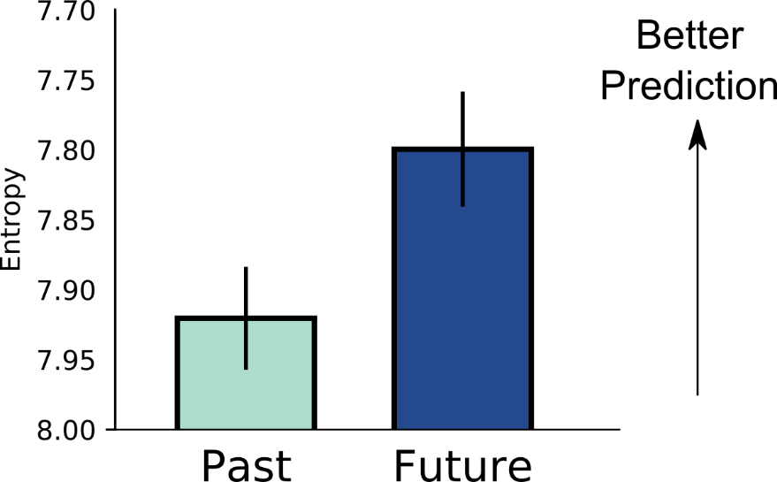
Notes:
Results for schema usage. We found (The same as in naturally occurring thoughts) that thoughts about the future used more schemas than thoughts about the past.

Slide 42
Topics Learned
Emory | Attend | Rode | Horse | Took
Meeting | Church | Raised | Dh | Attend
Birds | Park | Coming | Feeding | Saw
… N = 500
Notes:
Evaluation of topic model: semantic coherence. The first assumption is that the topic model is learning semantically coherent (and hopefully diverse) packets of inform ation. We can test this assumption in two ways: by looking at the topics (and asking how semantically coherent they are) and by asking people to rate the topics. Here are some fo the topics learned [figure of topics]. And we asked people to rate the semantic coherence of these topics, compared to topics from a semantically ablated model, and the humans rated them as more coherent.

Slide 43
Discussion
Same results with lab-elicited temporal thoughts
Notes:
Discussion: These results suggest that our results are not unique to naturally occurring temporal thoughts – but that temporal thinking in general may involve a use of schemas.

Slide 44
Summary
• Shared processes for past and future thinking
• Schemas, not episodic processing are the shared process
• Results do not depend on method of eliciting temporal thoughts
Notes:
Summary: We asked whether past and future thinking share a common cognitive process. We did this by studying millions of naturally occurring thoughts about time, and extracting linguistic indicators of the cognitive processes that people used to generate those thoughts.
The main finding is that past and future thinking do share common processes but that the use of schemas, not the use of episodic processes, is the key shared process.

Slide 46
Predictions
Episodic Language
Use of Schemas
Past Future
Past Future

